Slide 1
Graphic Novel Unit
Year 9

Slide 2
Learning Intentions
To explore allegory, icons, myths and symbolism.
To implement our understanding of these and portray them in graphic novel form.
To use punctuation, layout and font variations in constructing graphic novels.
To explain the use of symbols, icons, and myth and how these create meaning.

Slide 3
What are graphic novels?
Graphic novels are books written and illustrated in the style of a comic book.
To be considered a graphic novel, rather than a picture book or illustrated novel, the story is told using a combination of words and pictures in a sequence across the page.
Graphic novels can be any genre, and tell any kind of story, just like their prose counterparts. The format is what makes the story a graphic novel, and usually includes text, images, word balloons, sound effects, and panels.

Slide 4
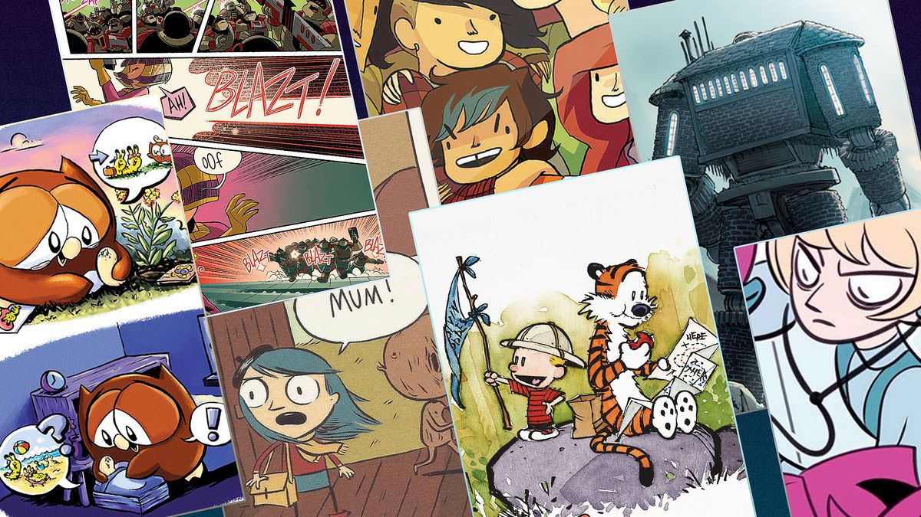

Slide 5
Both images and words tell stories.

Slide 6
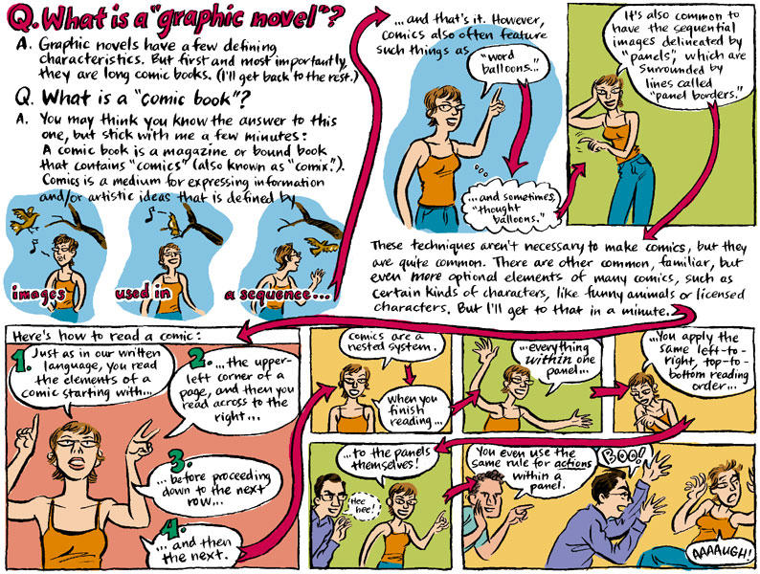

Slide 7
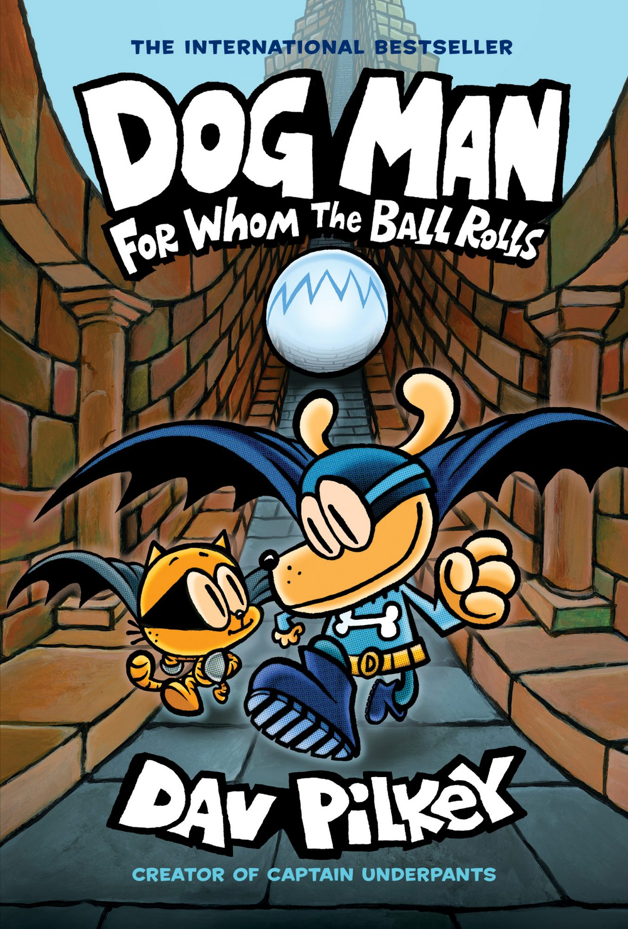
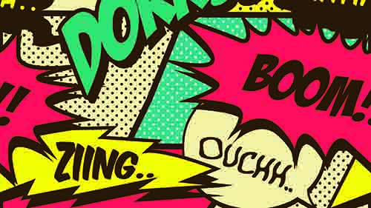
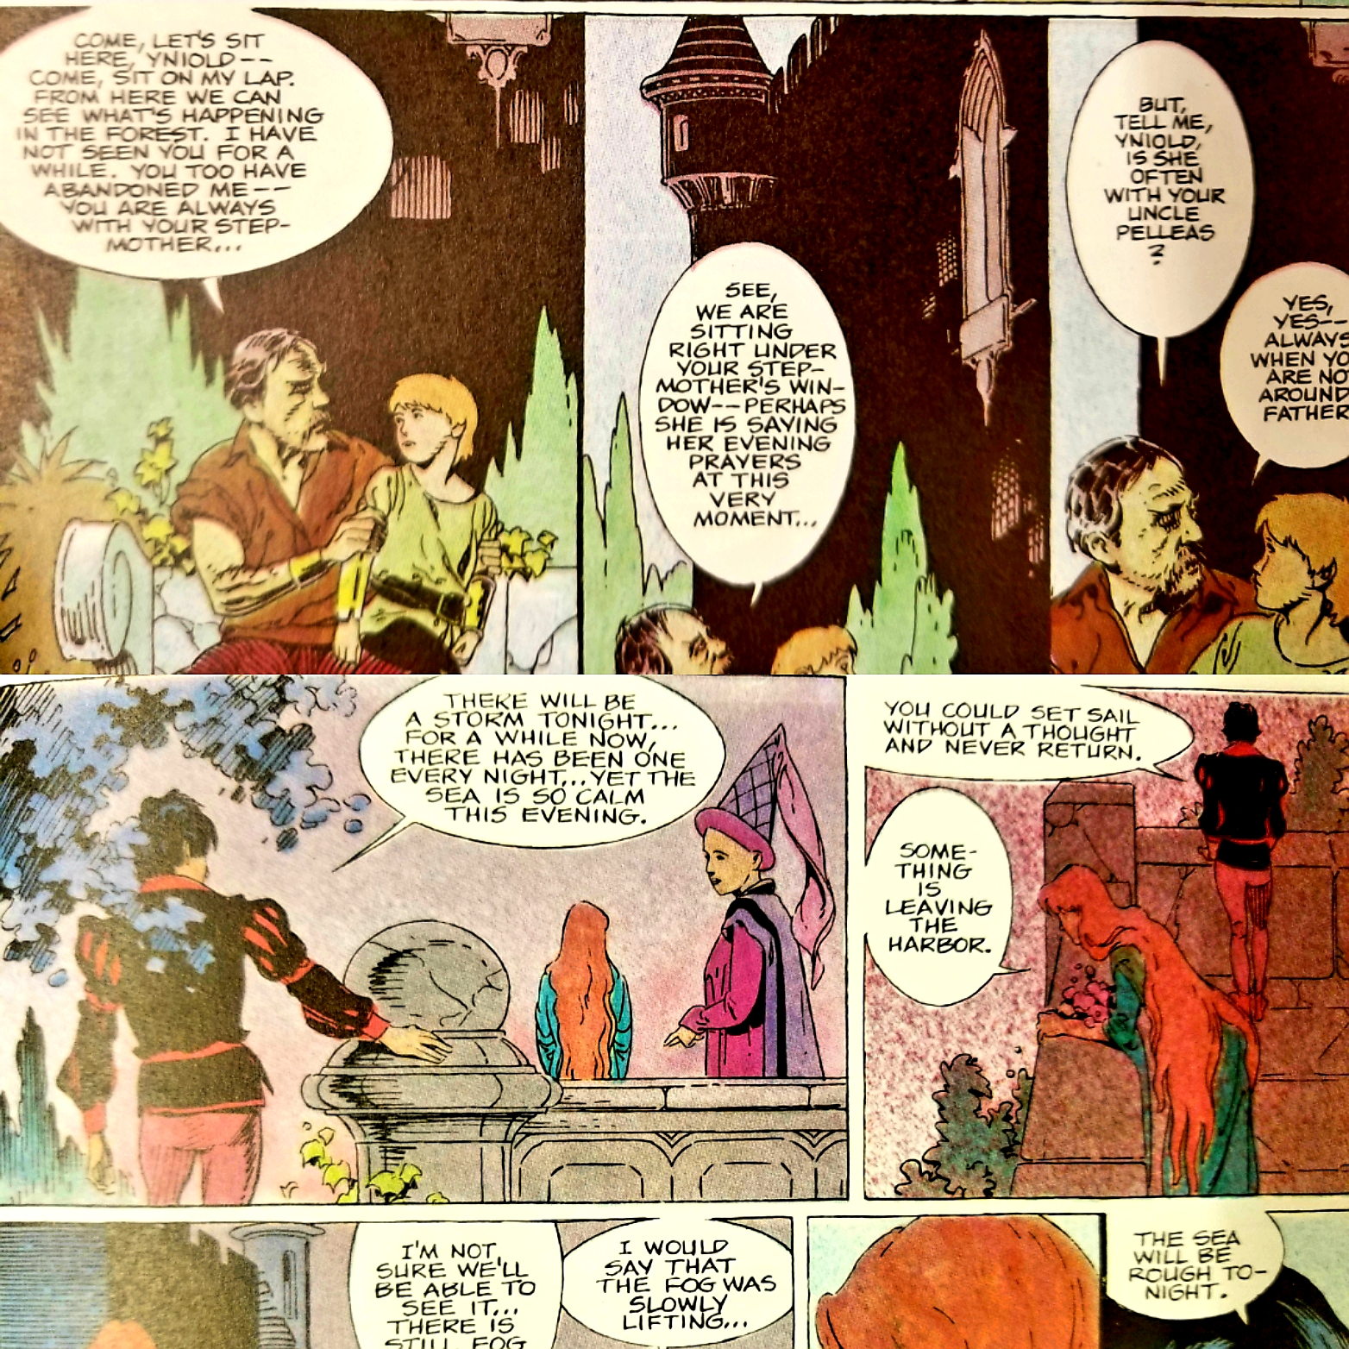
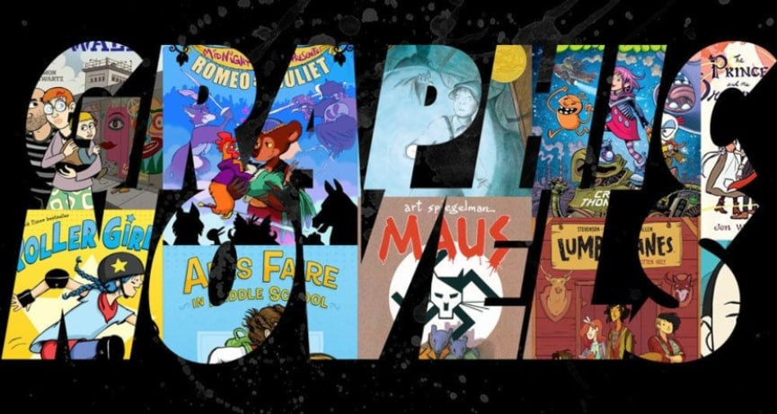
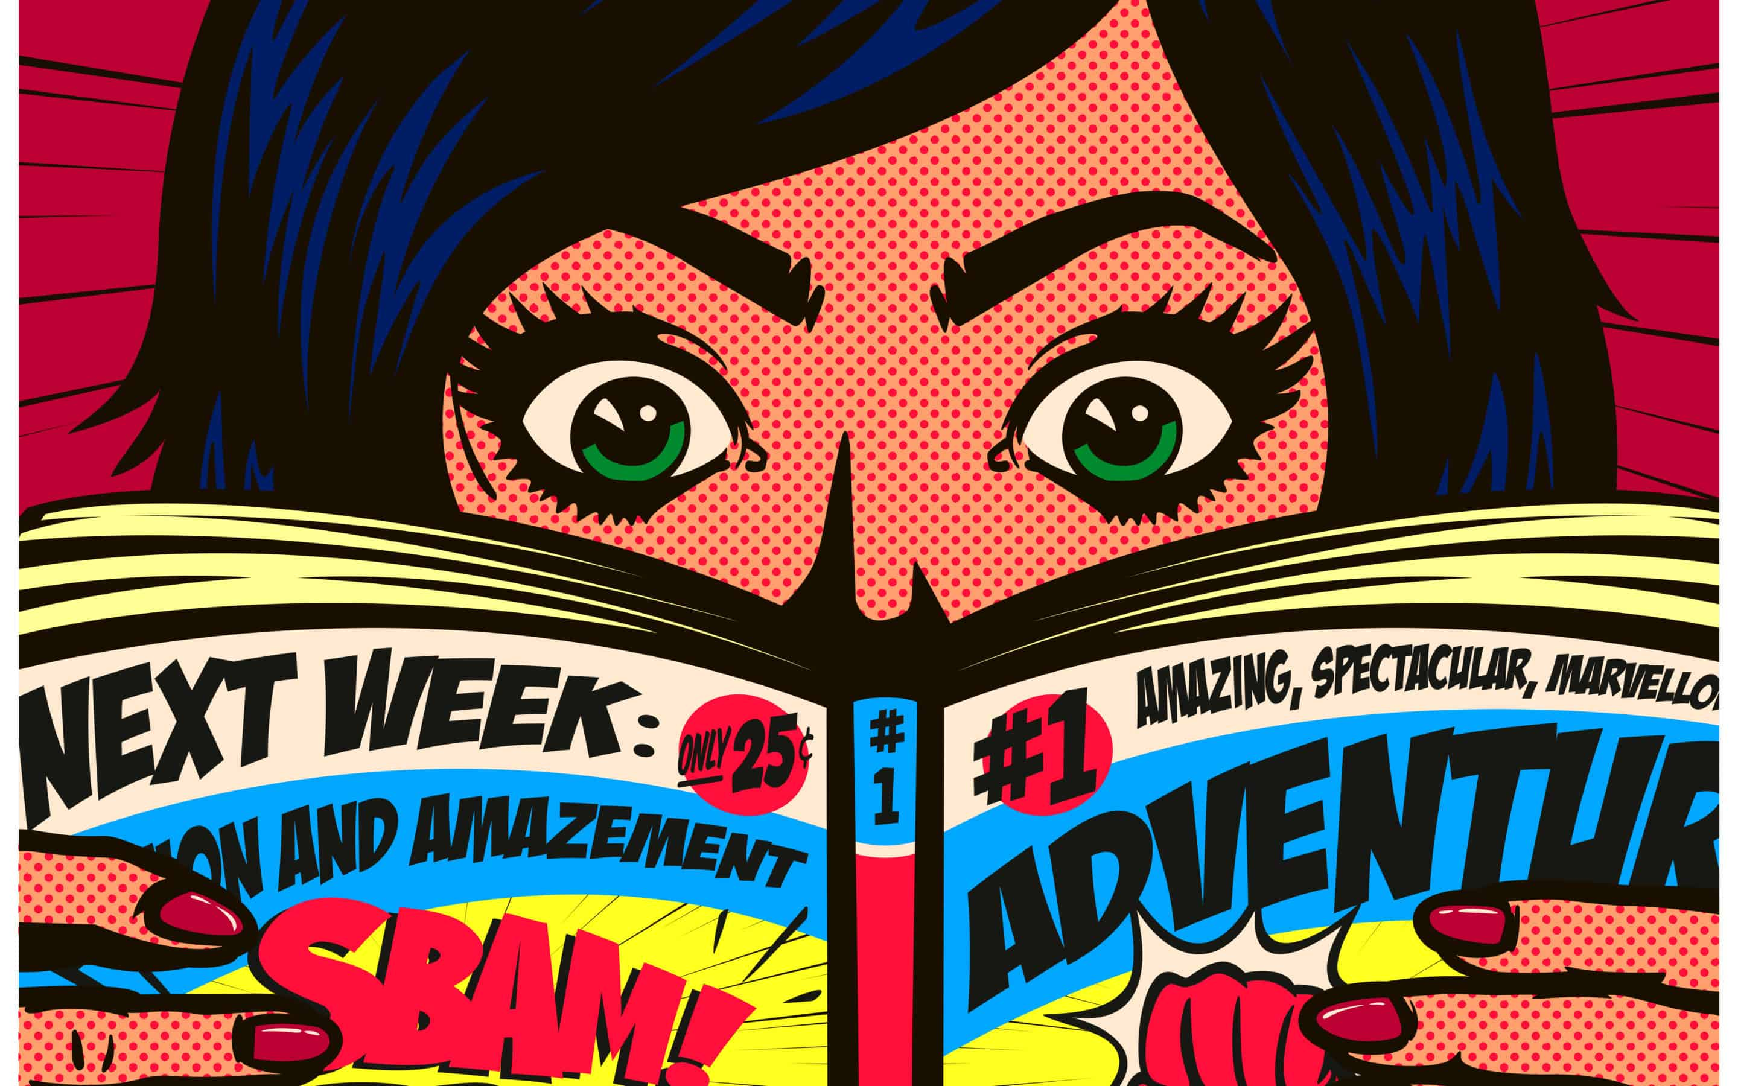
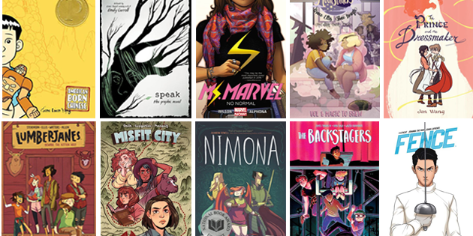

Slide 8
Graphic Novel Terms
Today we are going to create a dictionary of elements that are uniqueo to graphic novels and comic books.

Slide 9
Graphic Novel Terms
Speech Bubbles
Captions
Panels
Thought Bubbles
Sound Effects

Slide 10
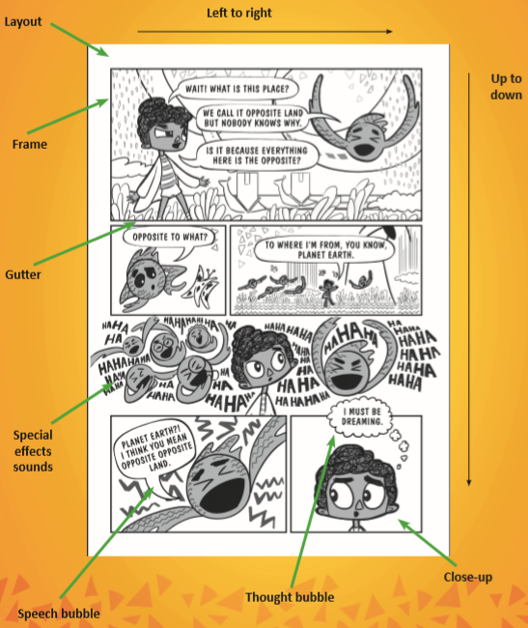

Slide 11
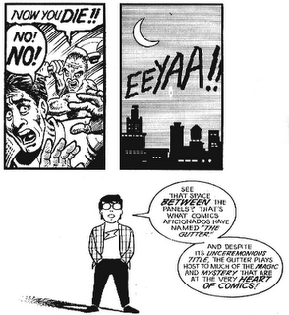
Analysing layout: the gutter
The space between panels is called the gutter. This space is actually important – as it allows the cartoonist to tell the story in a shorter, more condensed way.
It relies on the reader (YOU!) to use your imagination to fill in the gap in the story.
For example – we do not know who is screaming or how the axe was used but we all have an image in our mind

Slide 12
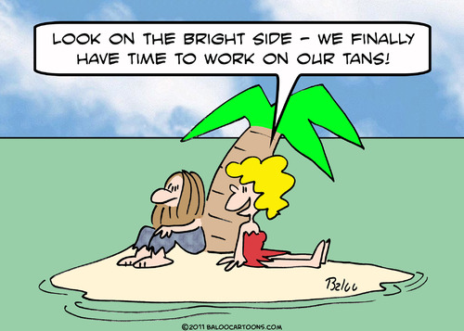
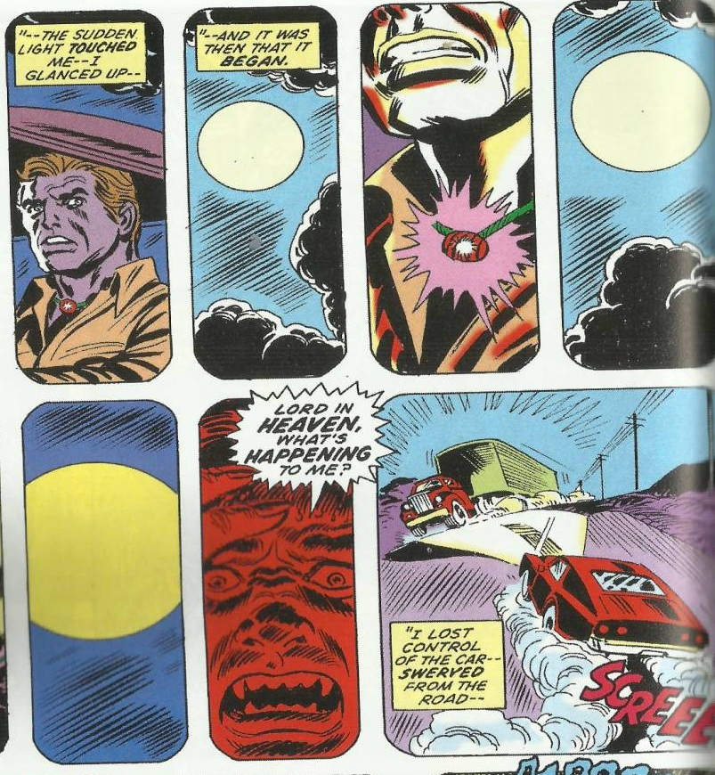
Analysing layout: Size of Panel
A single panel comic, like this one, cannot tell us a lot about time scale – a single panel is one moment in time.
But cartoonists can experiment with the size of the panel to show differences in time. This strip uses small panels to show how quickly the events are happening.

Slide 13
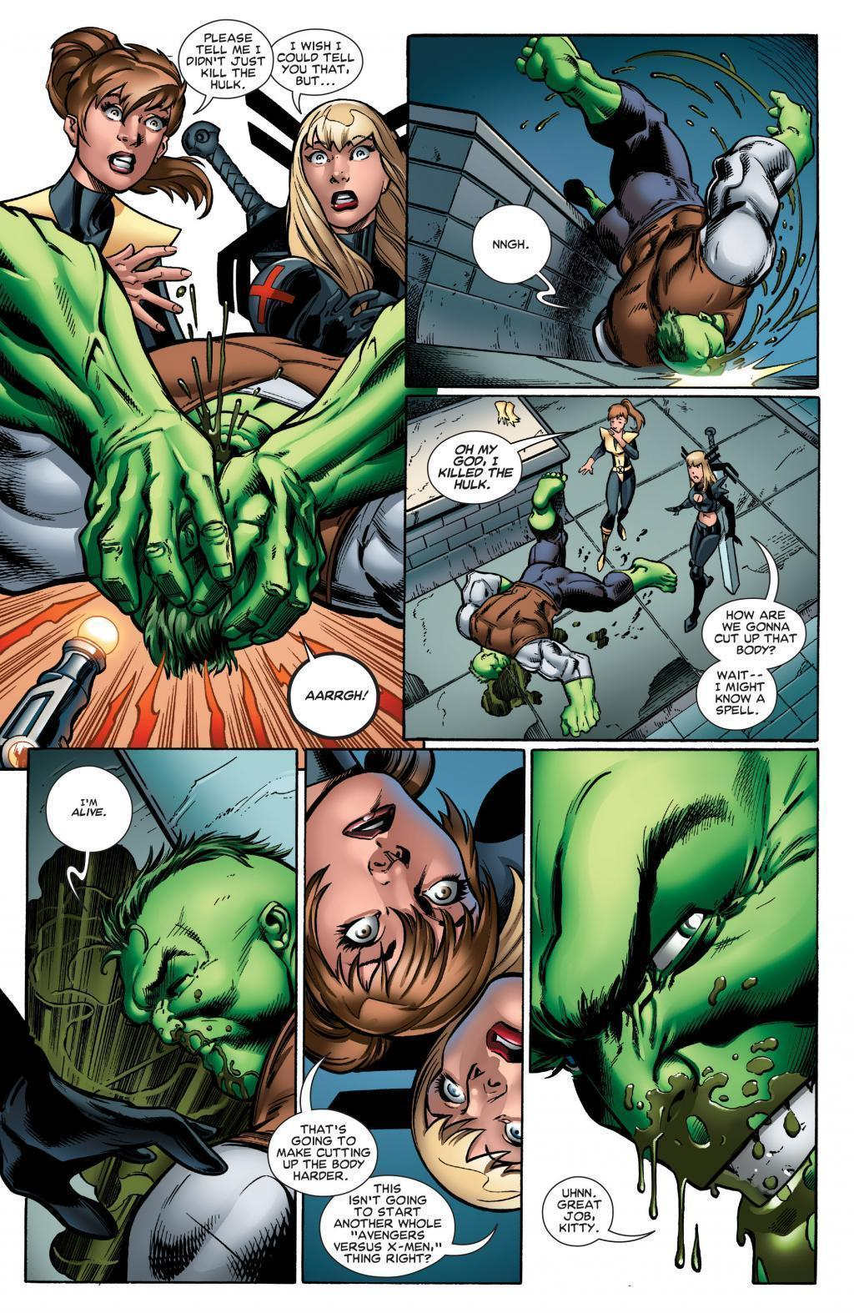
Analysing layout: Size of Panel
Panel size can also be altered to show movement or to emphasise a detail.

Slide 14
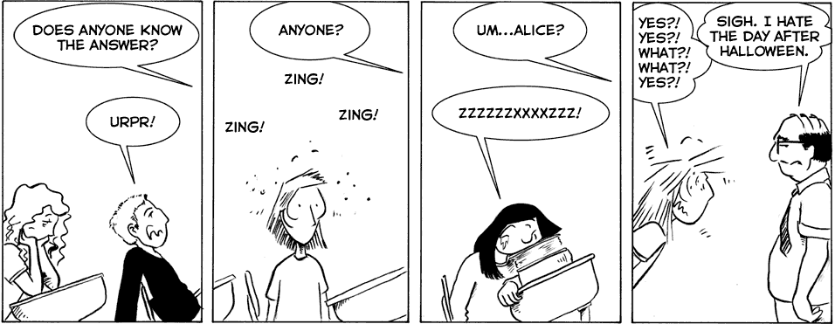
Analysing visuals: emotions
With only a few lines a cartoonist can convey a vast range of emotions
For example we know this girl is bored because her mouth is downturned and she has her head on her hands.

Slide 15
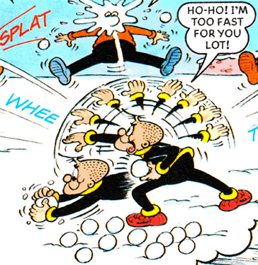
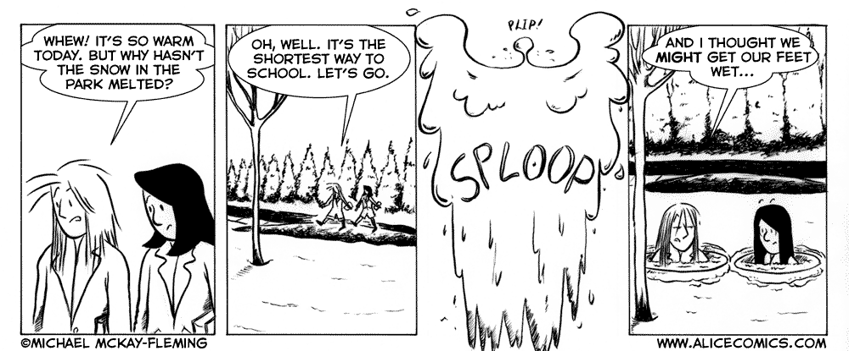
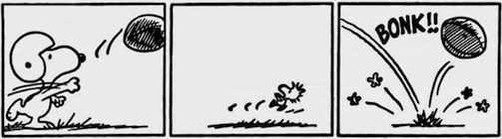
Analysing visuals: showing movement
A comic strip is just a series of static images and yet they are able to convey movement through MOTION LINES.

Slide 16

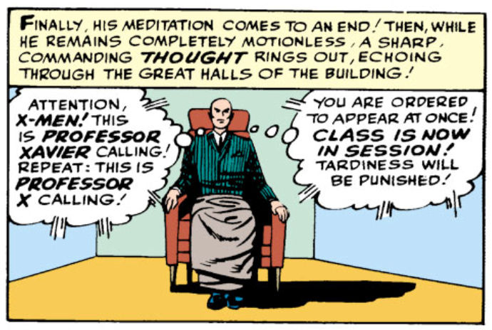
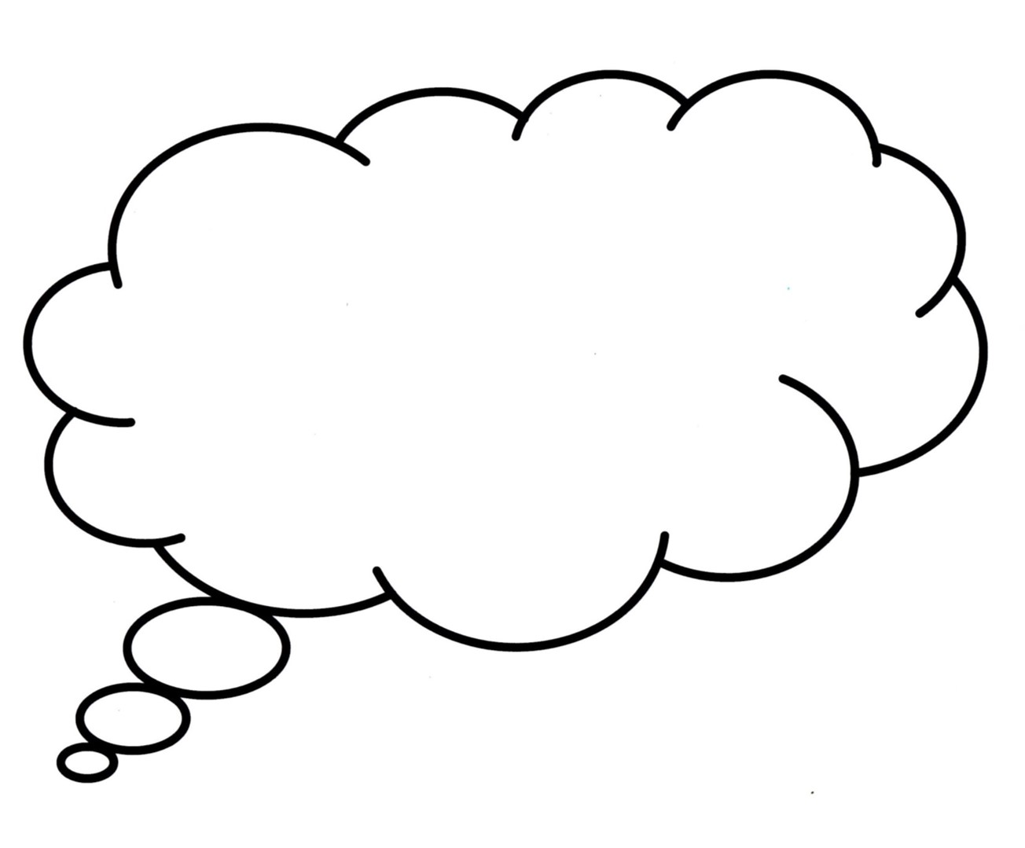

Graphic Novel Terms
Speech Bubbles
Captions
represent the speech of a character.
contain information about a scene or a character and are generally used to establish time and place.
Panels
contain the text and illustrations of a single scene.
Thought Bubbles
represent the thoughts of a character.
Sound Effects
or onomatopoeia’s are visual sound clues e.g. ‘zonk’ and ‘whoosh’.

Slide 17
Graphic Novel Exploration

Slide 18
Exploring allegory, symbols, icons and myths.
Do you know what helps you make your point clear? Lists like this one:
They’re simple
You can organize your ideas clearly
The audience won’t miss the point of your presentation

Slide 19

Aboriginal Culture
Symbols
Myths
Legends

Slide 20
Dreamtime Stories
Venus is terribly hot
Mercury is the smallest
Mercury is the smallest
01
02
Venus is terribly hot
Mars is a cold place
03
04
Jupiter is the biggest

Slide 21
SOMETIMES, REVIEWING CONCEPTS IS A GOOD IDEA
VENUS
SATURN
Venus has a beautiful name
Saturn is the ringed one
MARS
NEPTUNE
Mars is actually a cold place
Neptune is far away from Earth

Slide 22
Your Task
Creating a graphic novel extract

Slide 23
HERE YOU HAVE SIX COLUMNS
VENUS
MERCURY
SATURN
Venus has a beautiful name
Mercury is the smallest planet
Saturn is the ringed one
MARS
JUPITER
NEPTUNE
Mars is actually a cold place
It’s the biggest planet of them all
Neptune is far away from Earth

Slide 24
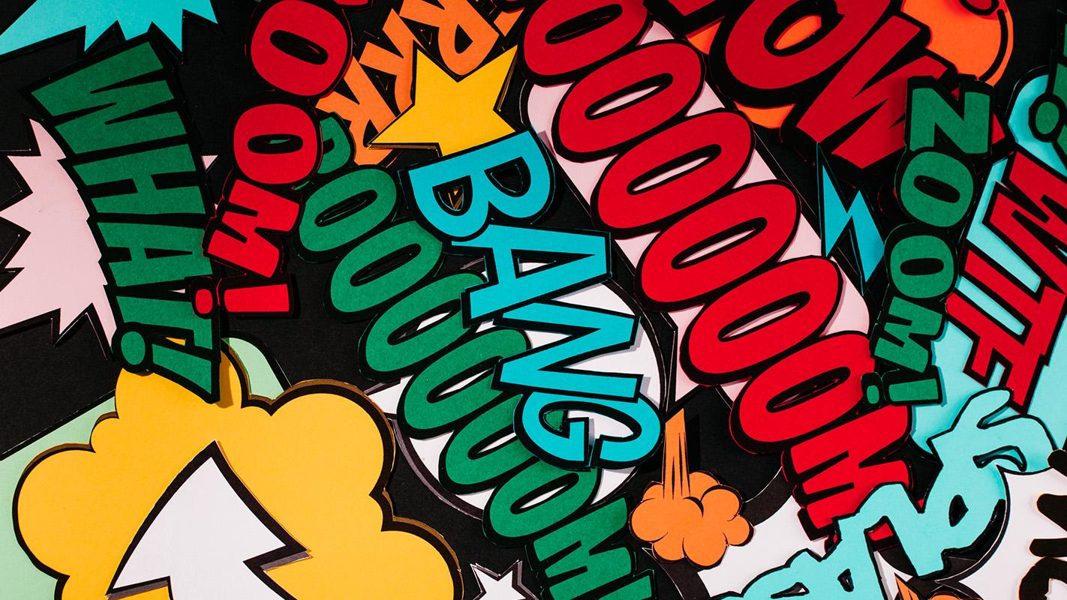
A PICTURE IS WORTH A THOUSAND WORDS

Slide 25
“This is a quote, words full of wisdom that someone important said and can make the reader get inspired.”
—SOMEONE FAMOUS

